Slide 1

Data Analytics - Cohort 14, Sec D
Project 1 - NorthWind
Rabbia Munir

Slide 2
Introduction:
The Northwind dataset is a well-known sample database that represents a fictional company, Northwind Traders, which specializes in the import and export of specialty food products.
Includes Orders,OrderDetails Customers, Products, Suppliers, Employees, and Categories Table.
This dataset comprises 809 orders, which we will analyze in terms of revenue, product sales, and customer behavior.

Slide 3
Business Questions:
Sales performance – Identifying revenue trends, best-selling products, and top-performing customers.
Customer segmentation – Understanding different types of buyers and their purchasing behaviors.
Order fulfillment – Evaluating shipping efficiency and average delivery times.
Employee performance – Assessing Top Employee’s contributions to the business.

Slide 4
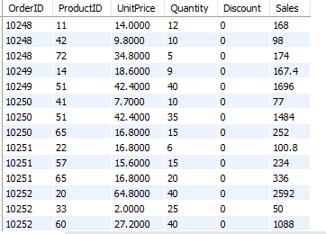
Data Transforming:
-- Add Sales (Gross Revenue) in OrderDetails table
alter table `order details` add Sales float(10);
update `order details`
set Sales= sum(UnitPrice * Quantity);

Slide 5
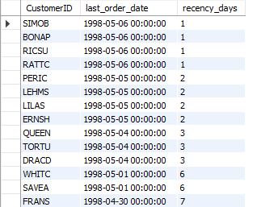
RFM Analyse:
-- Recency (R) – How recently a customer has made a purchase
SELECT
CustomerID,
MAX(orderDate) AS last_order_date,
DATEDIFF('1998-05-07', MAX(orderDate)) AS recency_days
FROM orders
GROUP BY CustomerID
order by recency_days;

Slide 6
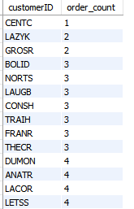
-- Frequency (F) – How often a customer makes purchase
SELECT
customerID, Count(OrderID) as order_count
FROM orders
GROUP BY customerID
ORDER BY order_count;

Slide 7
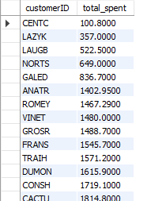
-- Monetary (M) – How much a customer has spent
SELECT
o.customerID,
SUM(od.quantity * od.UnitPrice) AS total_spent
FROM orders o
JOIN `order details` od ON o.orderID = od.orderID
GROUP BY o.customerID
ORDER BY total_spent;

Slide 8
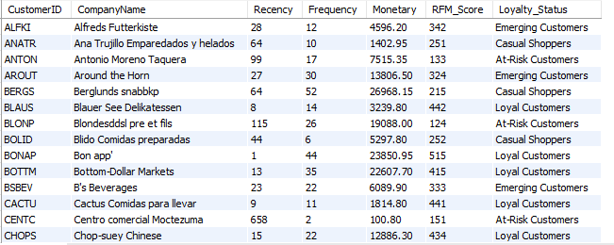
RFM table:

Slide 9
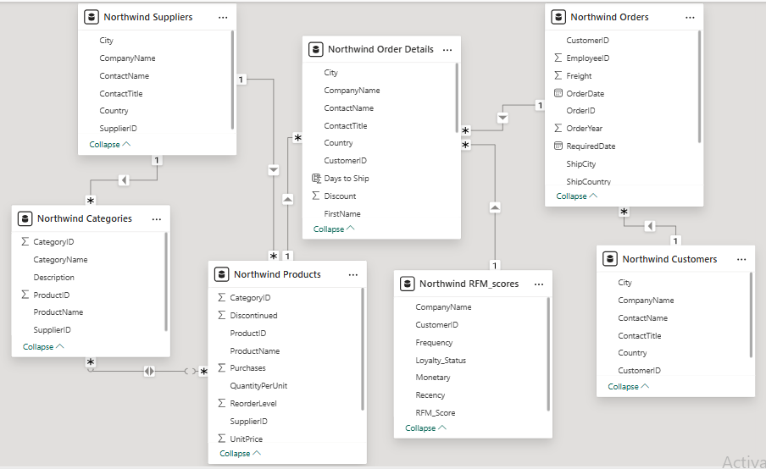
ER Diagram

Slide 10
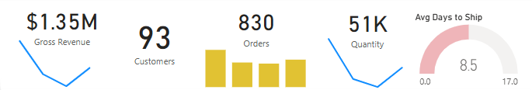
Key Metrics & KPIs
$1.35M Gross Revenue
93 Customers & 830 Orders
51K Quantity Sold
Average Days to Ship: 8.5 Days

Slide 11
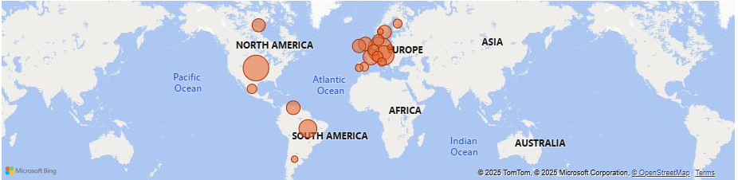
Sales & Revenue Analysis
A geographical heatmap indicating revenue from different countries.
Red circles show revenue contribution by different cities.

Slide 12
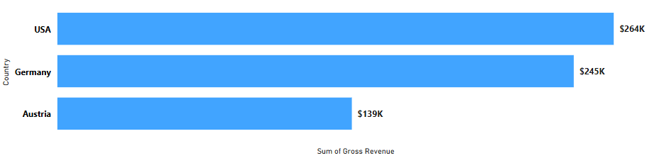
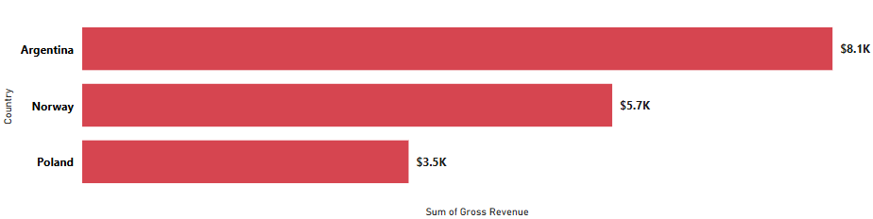
Sales & Revenue Analysis
Bar chart shows Top 3 Countries and Bottom 3

Slide 13
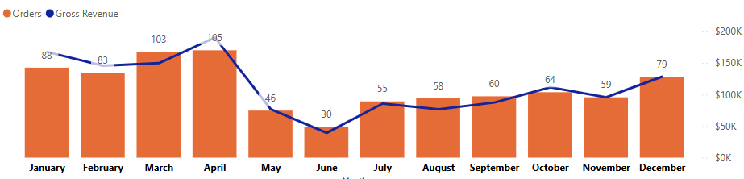
Sales & Revenue Analysis
A geographical heatmap indicating revenue from different countries.
Red circles show revenue contribution by different cities.
Table listing Top 3 Countries and Bottom 3

Slide 14
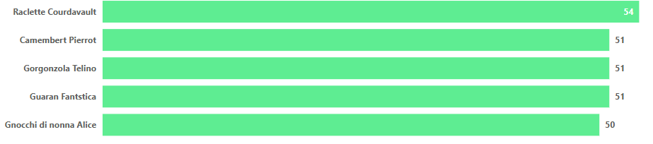
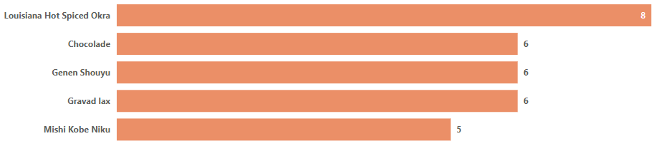
Product & Category Analysis
Bar chart highlighting the top/bottom 5 products by order.

Slide 15
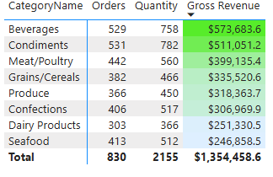
Product & Category Analysis
Table displaying revenue per category/Product.

Slide 16
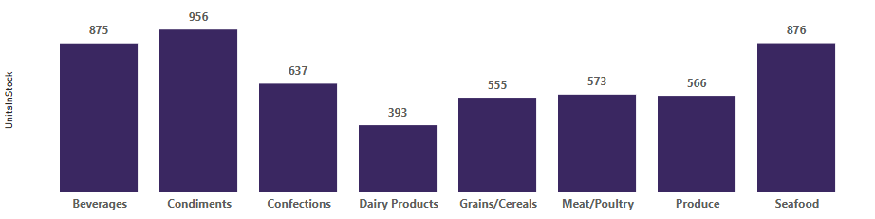
Product & Category Analysis
Bar chart showing stock units per category.

Slide 17
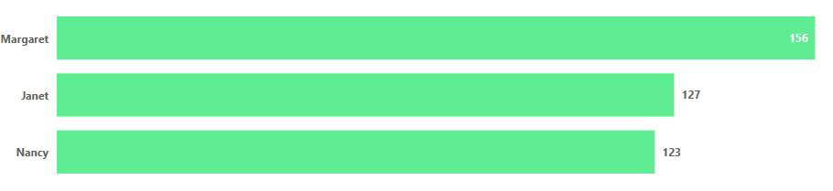
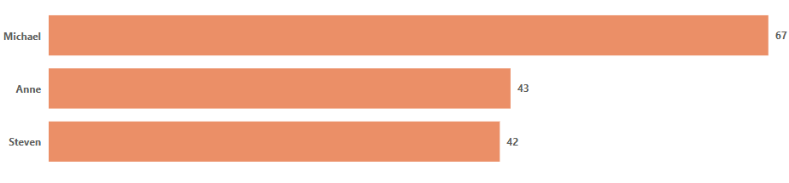
Employee Performance Analysis
Clustered Bar charts showing top and bottom employees by order count.

Slide 18
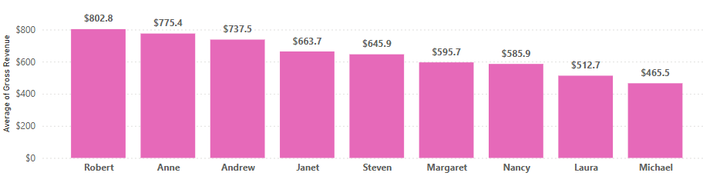
Employee Performance Analysis
Stacked Column Chart showing average gross revenue per order by employee.

Slide 19
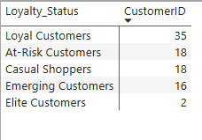
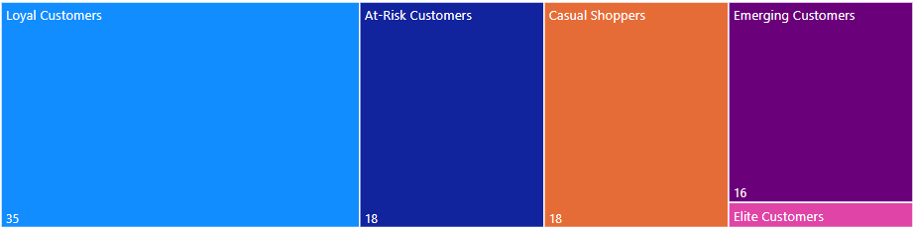
Customers Analysis
Segmentation Treemap

Slide 20
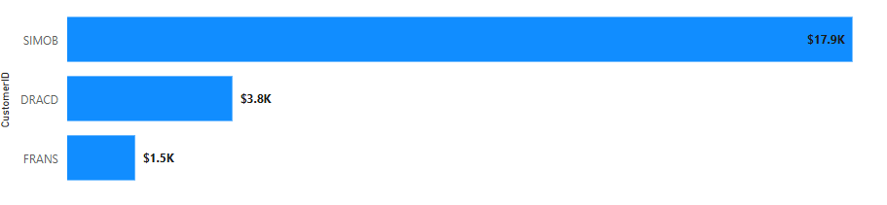
Customers Analysis
Top 3 Customers by Gross Revenue Bar Chart

Slide 21
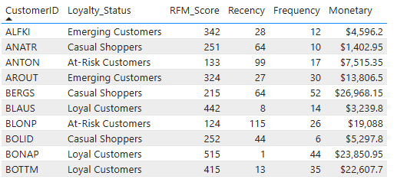
Customers Analysis
Snapshot of RFM Table

Slide 22
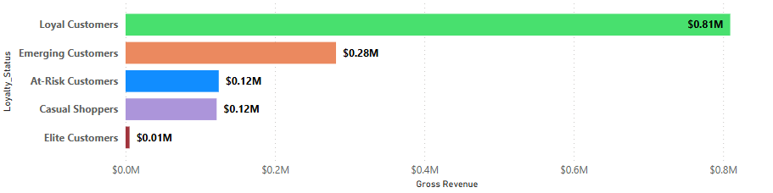
Customers Analysis
Sales by Segmentation Bar Chart

Slide 23
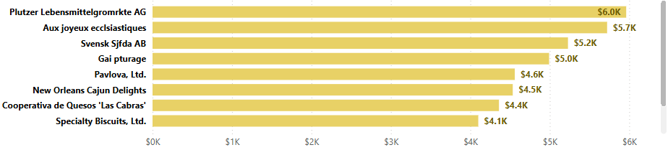
Supplier & Shipping Insights
Bar chart displaying the top 10 suppliers and their total purchase values.

Slide 24
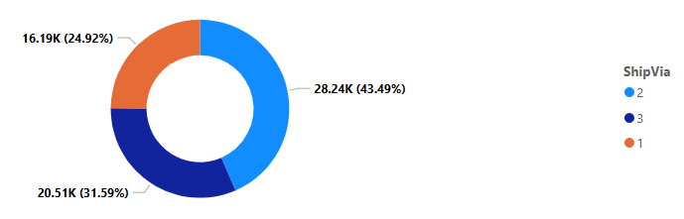
Supplier & Shipping Insights
Pie chart illustrating the proportion of freight handled by different shipping methods.

Slide 25
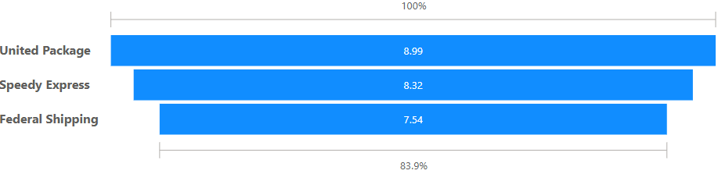
Supplier & Shipping Insights
Bar chart displaying the average days to ship for different shipping companies.

Slide 26
Conclusion
The Northwind dashboard provides comprehensive insights into business performance across revenue, orders, employees, customers, and suppliers. The key findings include:
Revenue & Orders: The company generated $1.35M in gross revenue from 830 orders, with notable seasonal fluctuations.
Europe & North America dominate supplier locations. USA has highest Revenue while Poland has Lowest.
Shipping & Logistics: The average shipping time is 8.5 days, with "United Package" performing best. ShipVia 2 handles the most freight, suggesting dependency on one carrier.
Top-performing Categories: Beverages and Condiments lead in revenue, while Seafood has the lowest sales.
Employee Performance: Margaret, Janet, and Nancy are top-performing employees, whereas Michael, Anne and Steven need improvement.Top sales employees significantly impact revenue.
Customer Segmentation: Loyal customers contribute the most revenue ($0.81M), while at-risk customers need retention strategies.

Slide 27
Recommendations:
Optimize Supply Chain: Reduce average shipping time by working closely with lower-performing shipping companies.
Boost Underperforming Products: Promote slow-selling products through discounts or marketing.
Employee Incentives: Implement rewards for low-performing employees to improve efficiency and sales.
Improve Customer Retention: Implement loyalty programs to convert casual and at-risk shoppers into Loyal customers.
Expand High-Performing Markets: Focus on top revenue-generating countries (USA, Germany, Austria) for further business growth.
Expand high-performing product categories.

Slide 28
Thankyou

